Slide 1
Student/Learner Login

Slide 2
Why you should create an account to use your Student/Learner Login
With a Student Login, you can:
check your entries and results are accurate
order copies of your Level 1, 2 and 3 NCEA certificates
print your Record of Achievement (RoA)
update your personal details, such as email address
print copies of your exam admission slip
access the digital exam platform
request reviews or reconsiderations of your external exam papers.

Slide 3
How do you create an account to use your Student/Learner Login?
Go to the NZQA home page: www.nzqa.govt.nz
Select to log in or create an account
Notes:
Where to go to on the NZQA website to login.

Slide 4
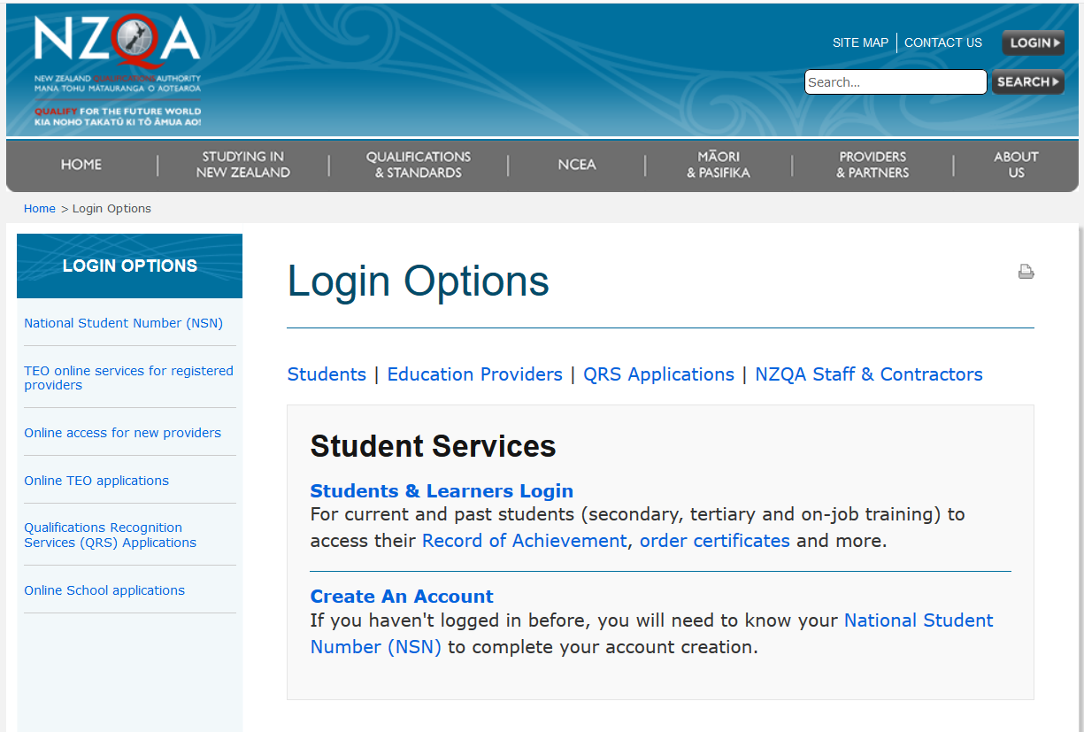
Select this link to log in if you have an account
Select this if you are a first time user
Notes:
Login
First time users must register first through this link.
Students new to NCEA will be unable to register here until their school has sent through its first submission file to NZQA, (usually May 1st).

Slide 5
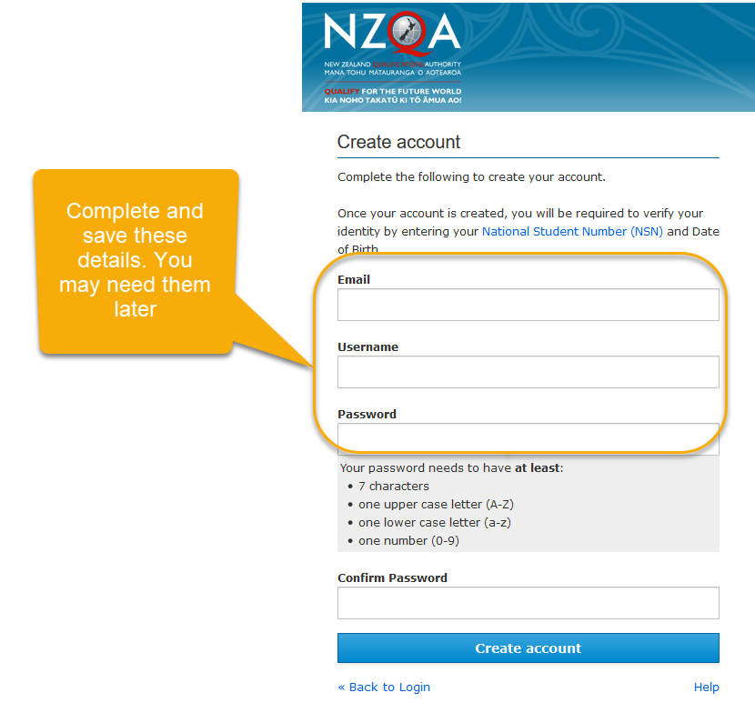
Create an account page
You must create an account before you can log in

Slide 6
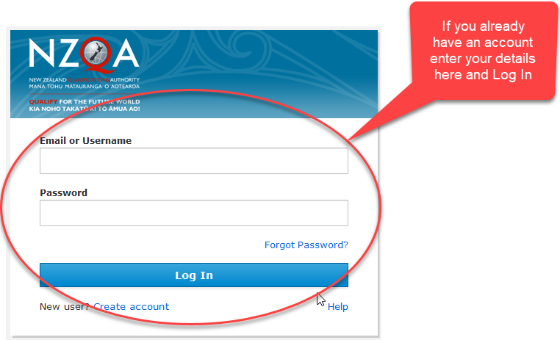
Login page
Use this page once you have created an account
Notes:
Learner login
The call centre (0800 697 296) can help with resetting passwords or other problems.

Slide 7
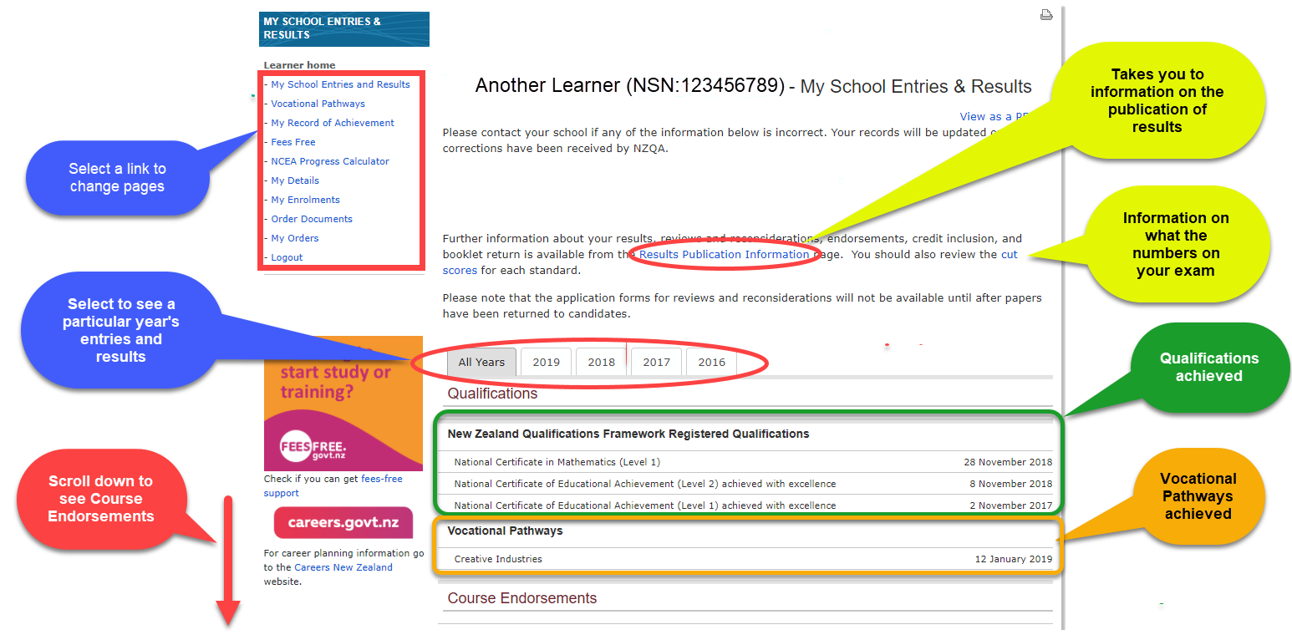
How can I check my entries and results?
Notes:
Learner home - My School Entries and Results
Year tabs: these allow students to quickly move between their results from individual years, as well as see a chart of their cumulative results (Credit Summary - All Years).
Qualifications, awards and endorsements only show under the All Years tab, while the Course Credit Summaries only appear under the individual year tabs (e.g. slide 12).
Scroll down for further information.

Slide 8
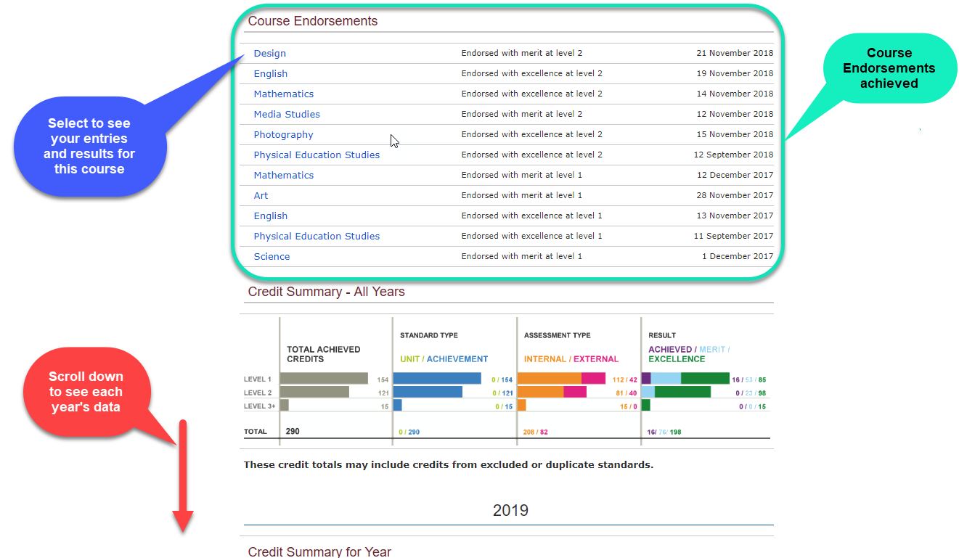
Notes:
Learner home - My School Entries and Results
Course Endorsements (in All Years tab)
This shows any course endorsements achieved. Each subject is a link (shown in blue).
For example – The History course is selected and a new screen will be opened with more details of the course, results and the endorsement.

Slide 9
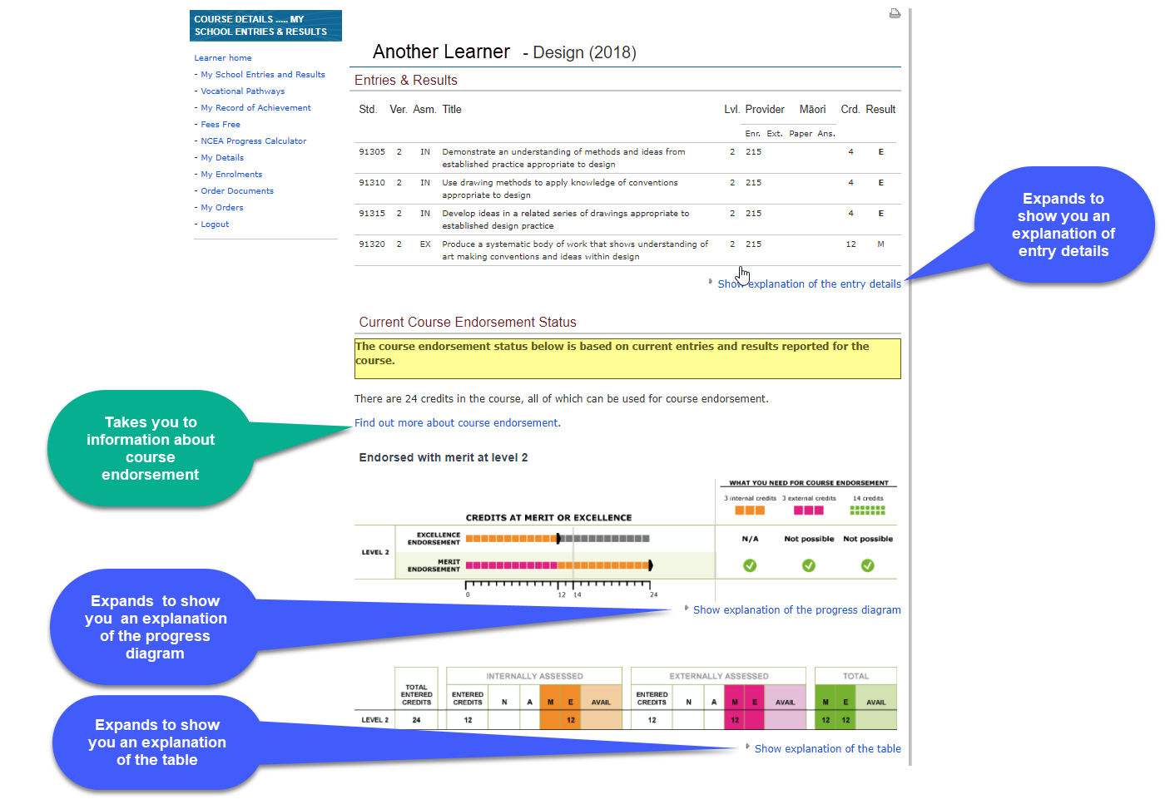
Course Endorsement information
Notes:
Learner home - My School Entries and Results
Course Endorsements (in All Years tab)
This shows the Entries and Results for the specified course
Std. Standard number. (All "9xxxx" series are achievement standards and all other reference numbers are unit standards.)
Ver. Standard version number.
Asm. Assessment mode, Internal (IN) or External (EX).
Provider The code of the assessing organisation.
Māori Indicates if an external standard was completed in te reo Māori.
Crd. Credits achieved.
Result The result achieved. Note that each standard can have a range of results including "N" for not achieved, "A" for achieved, "M" for achieved with merit, or "E" for achieved with excellence. As some standards can not be awarded all of these results the result code is shown in bold where a candidate has achieved the maximum possible result for that standard. N - Not achieved A - Achieved M - Achieved with merit E - Achieved with excellence ABS - Absent SNA - Standard not attempted RNA - Result not yet available
Scroll down for further information.

Slide 10
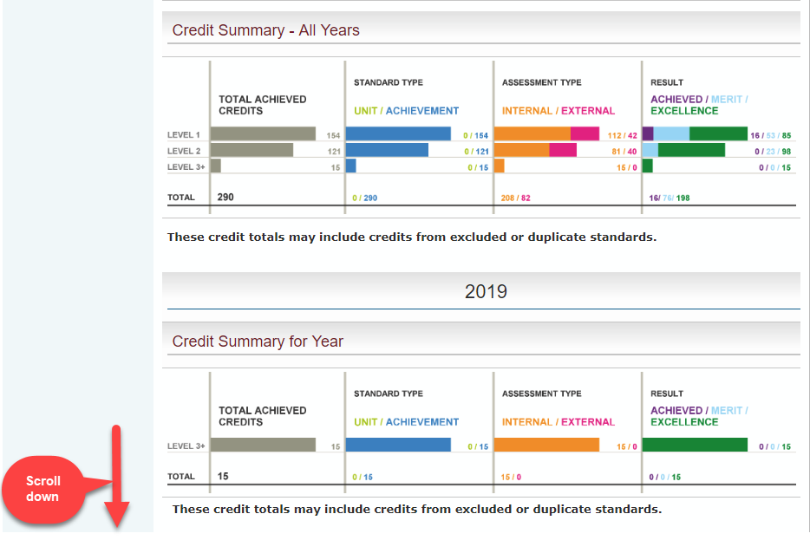
Credit Summaries
Notes:
Learner home - My School Entries and Results
From All Years tab showing Credit Summaries for All Years and one individual year (2014).
Scroll down for further information.

Slide 11
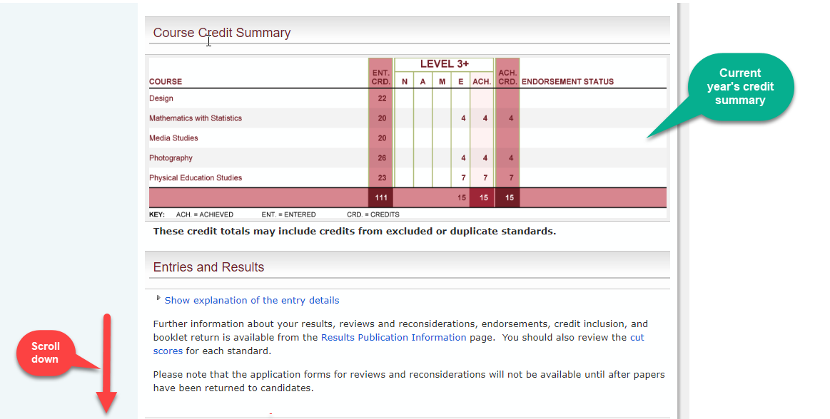
Notes:
Learner home - My School Entries and Results
2014 Tab showing Course Credit Summary for that year. Endorsements are also indicated on the table.
Scroll down for further information.

Slide 12
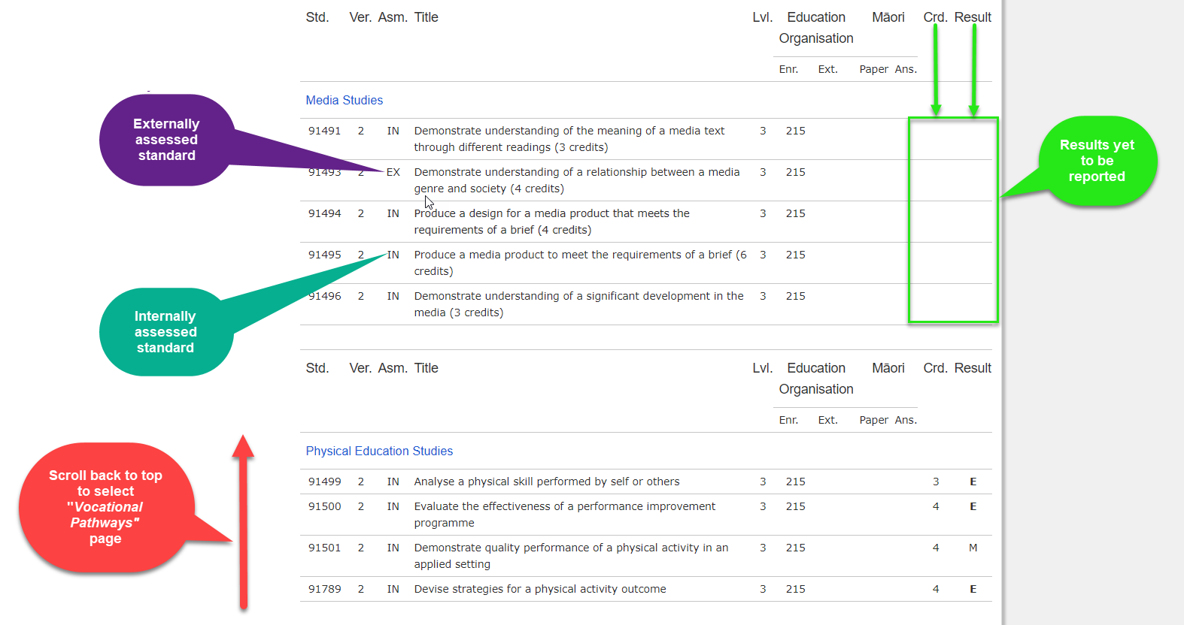
Notes:
Learner home - My School Entries and Results
EX - externally assessed standards.
This shows the standards currently entered in for the end of the year exams.
Students should check these entries carefully for accuracy before the end of August.
The September 1st data file to NZQA confirms all entries into externally assessed standards including Scholarship for candidates to receive personalised papers.
No withdrawals from externally assessed standards can be made after September 1st.
Results will be entered for these standards at the completion of the NZQA external examination process.
IN - internally assessed standards.
Competed internally assessed standards show the result and if applicable the credit amount gained.
No withdrawals from internally assessed standards can be made after December 1st
Education Organisation
Enr. – Enrolled school. This is the code of the ‘home school’ of the student, the school they are enrolled in.
Ext. – Where assessment is undertaking with an outside provide the outside provider code will show here. In this example 498 indicates a course undertaken through Te Kura / The Correspondence School.

Slide 13
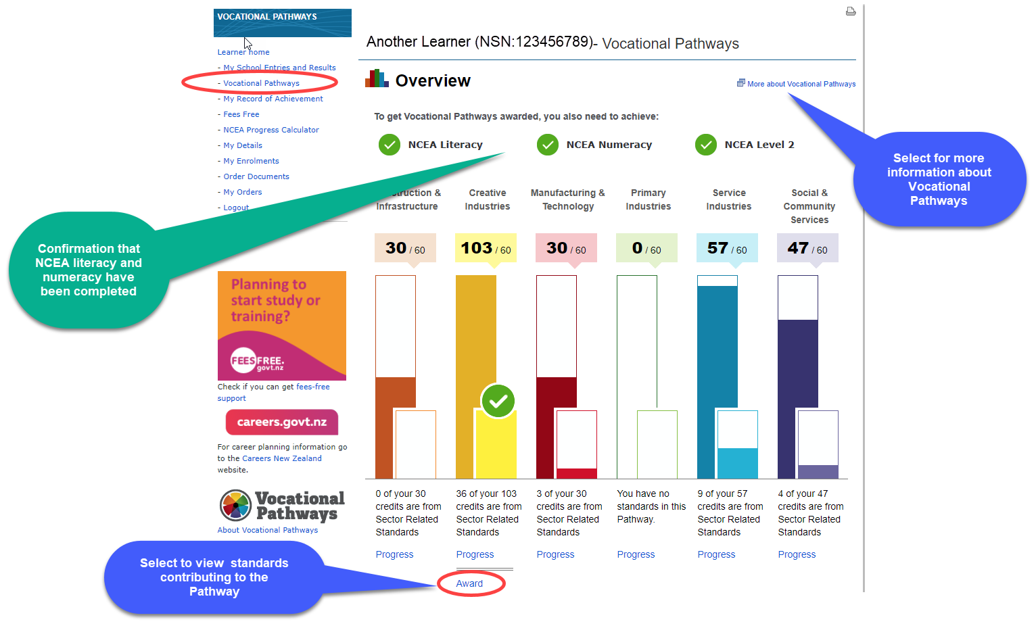
Vocational Pathways
Notes:
Learner home - My School Entries and Results
Vocational Pathways
This page provides an overview of the student’s progress towards the award of Vocational Pathways – in this case the student has meet the requirements for the award of the Creative Industries Vocational Pathway.
Selecting the Award link will provide further details about the Pathway award
For further information refer to Vocational Pathways Profile & Award on the NZQA website.
http://www.nzqa.govt.nz/qualifications-standards/awards/vocational-pathways/

Slide 14
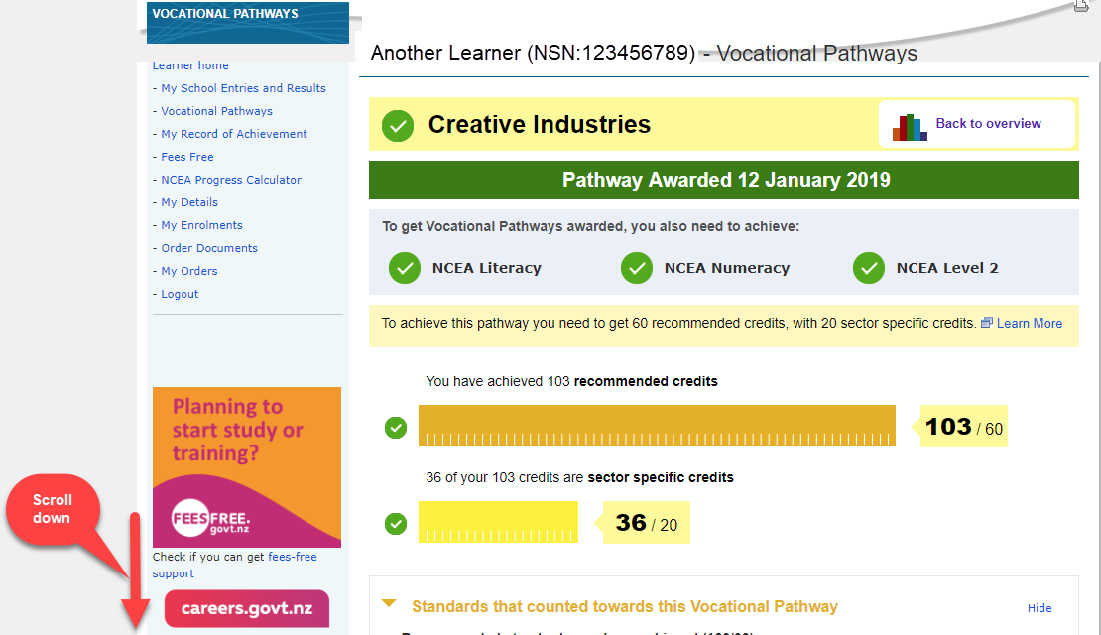
Notes:
Learner home - My School Entries and Results
Vocational Pathways
Information on the Pathway award, including date the award was made and the number of credits that could be counted for the recommended and sector specific sections of the award.
Scrolling down the page will provide information about the standards that contributed towards the pathway (next slide).

Slide 15
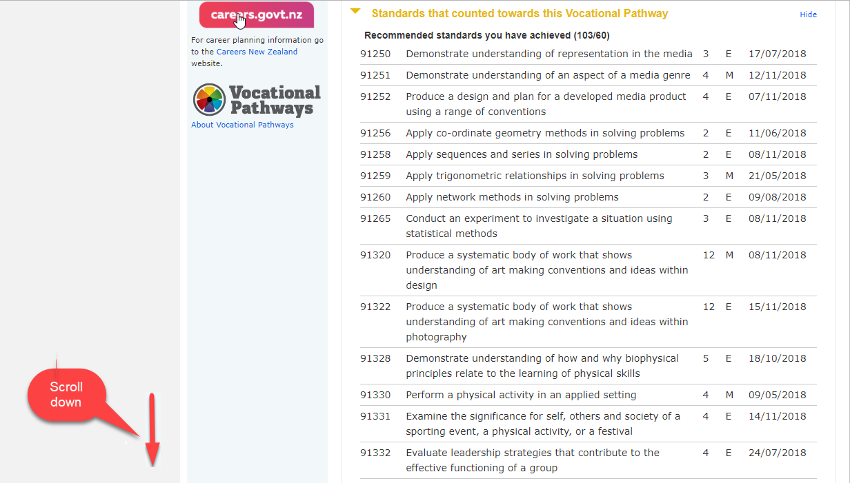
Notes:
Learner home - My School Entries and Results
Vocational Pathways
Those standards which counted towards the Pathway award are listed (in numerical order).

Slide 16
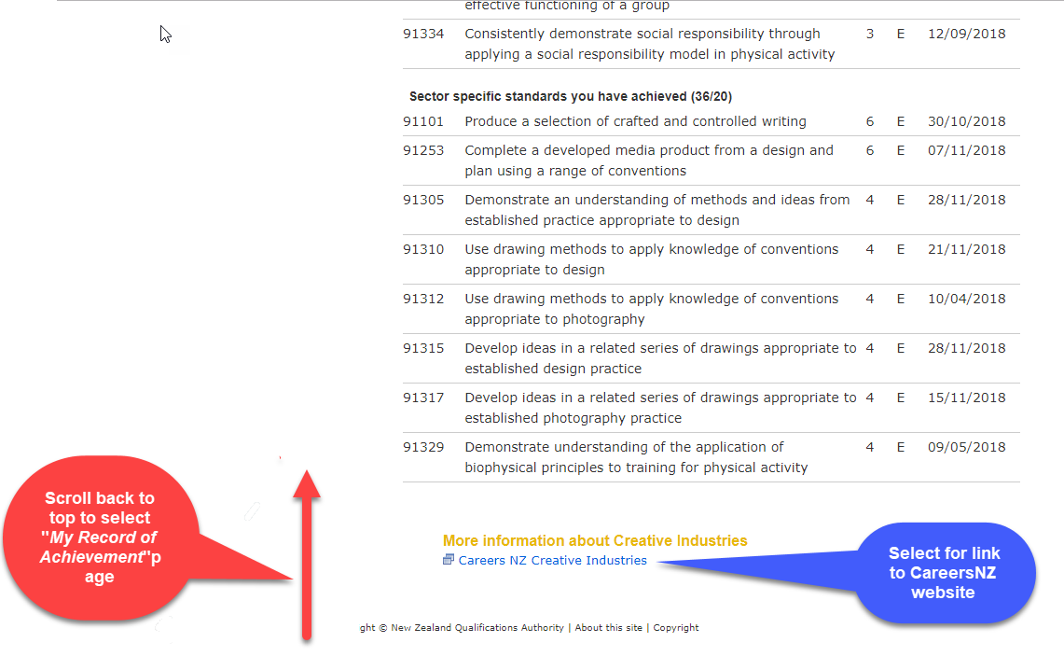
Notes:
Learner home - My School Entries and Results
Vocational Pathways
Link to Careers NZ which will provide further information on the Vocational Pathway awarded (see next slide).

Slide 17
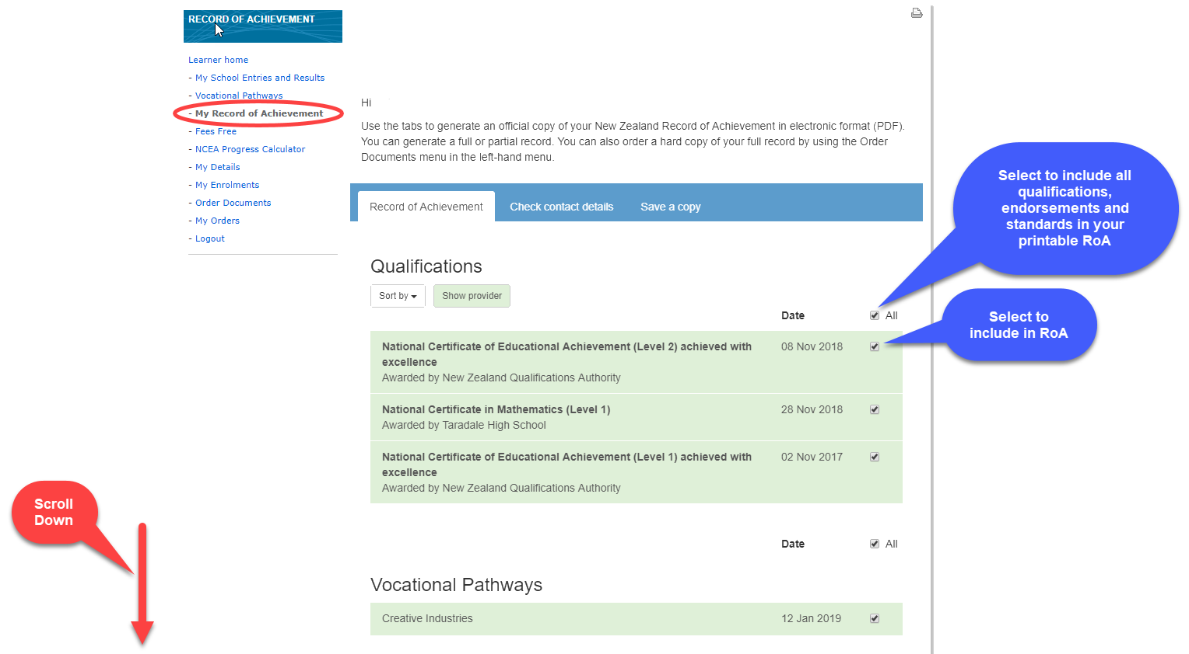
Your Record of Achievement
Notes:
Learner home - My School Entries and Results
My Record of Achievement

Slide 18
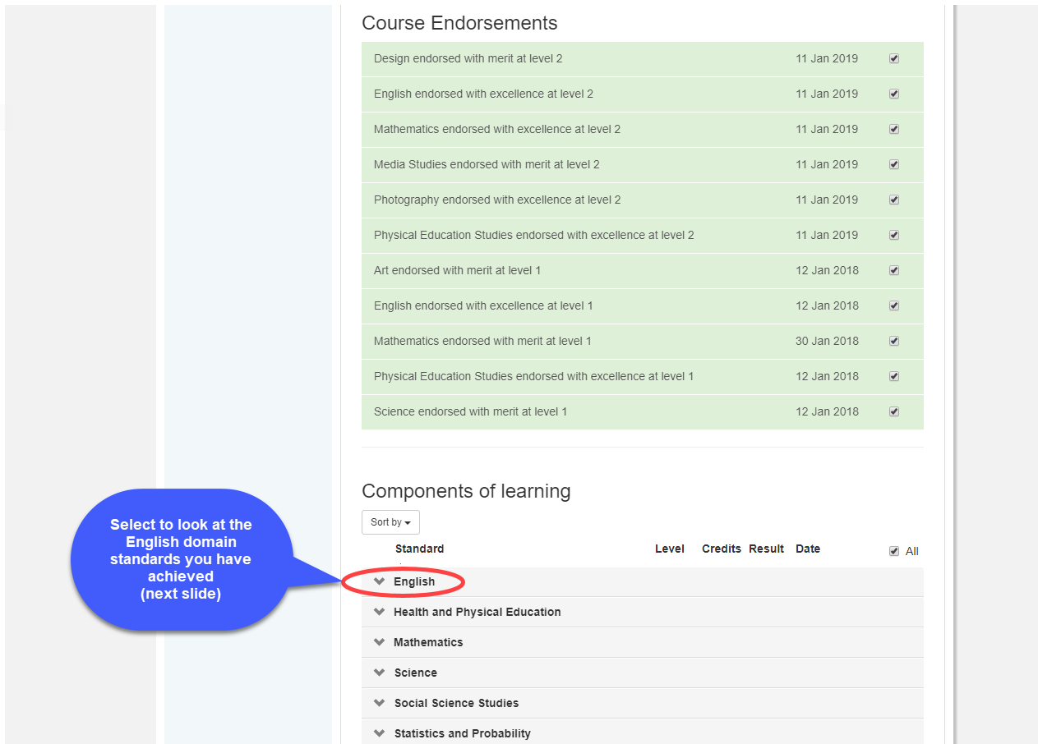
Notes:
Learner home - My School Entries and Results
My Record of Achievement

Slide 19
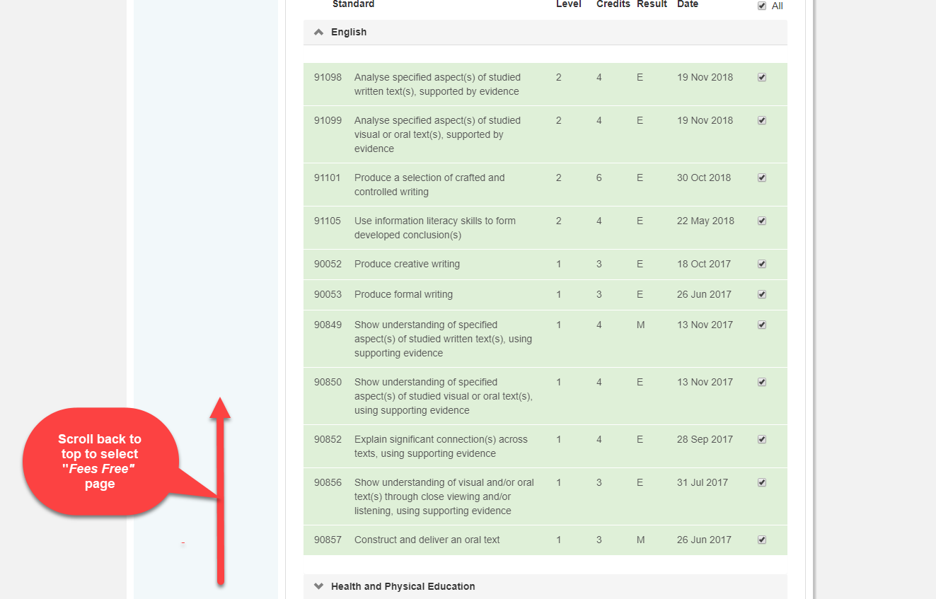
Notes:
Learner home - My School Entries and Results
My Record of Achievement
Results show by highest level first within each domain (e.g. Level 2 English results are listed above Level 1 English results).
As some standards can have a range of results including "N" for not achieved, "A" for achieved, "M" for achieved with merit, or "E" for achieved with excellence. As some standards can not be awarded all of these results, the result code is shown in bold where a candidate has achieved the maximum possible result for that standard.

Slide 20
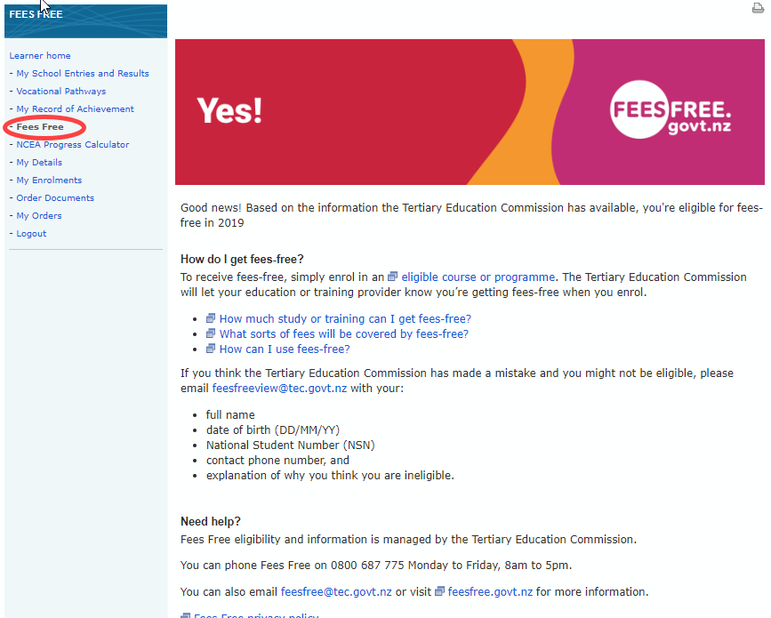
Checking your eligibility for fees free tertiary study

Slide 21
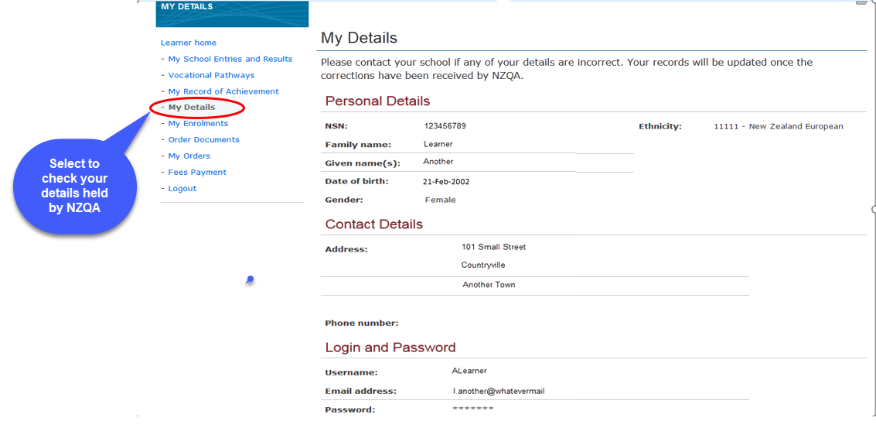
Checking your details held by NZQA

Slide 22
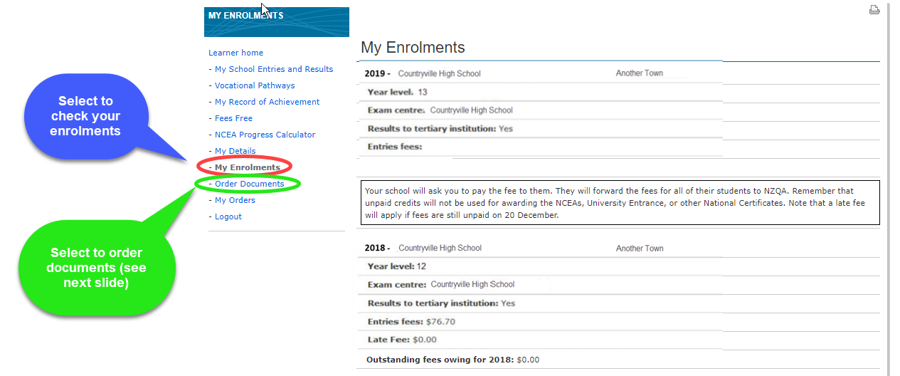
Check your NZQA Enrolments
Notes:
Learner home - My School Entries and Results
My Enrolments
Student’s enrolment – most current at top.
Results to tertiary institution – This allows NZ and Australian universities access to results.
Fee information

Slide 23
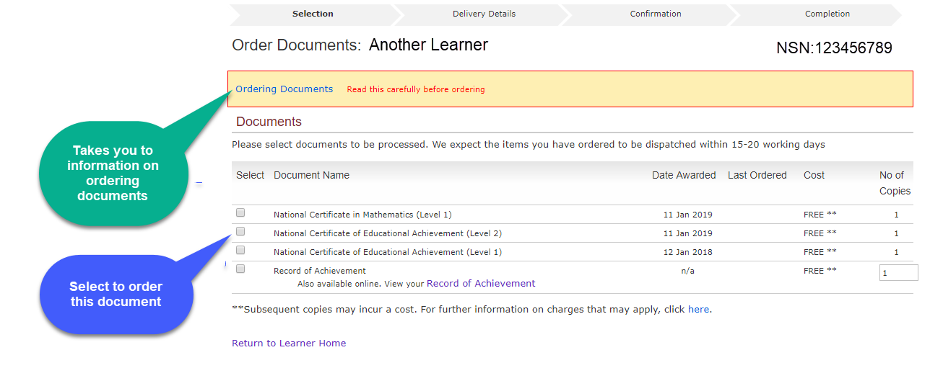
Ordering certificates and other documents
Notes:
Learner home - My School Entries and Results
Order Documents
If fees are paid, students are eligible for a copy of each Certificate achieved that year, one copy of their RoA and one current year Results notice free. Further orders cost $15.30 each.
Students should be encouraged to wait until all reviews and reconsiderations are completed BEFORE making any orders.

